Slide 1
Bone Conduction Military Helmet
Atharv Kotwal
Manan Tayal
Amey Gohil
Milind Chandnani

Slide 2
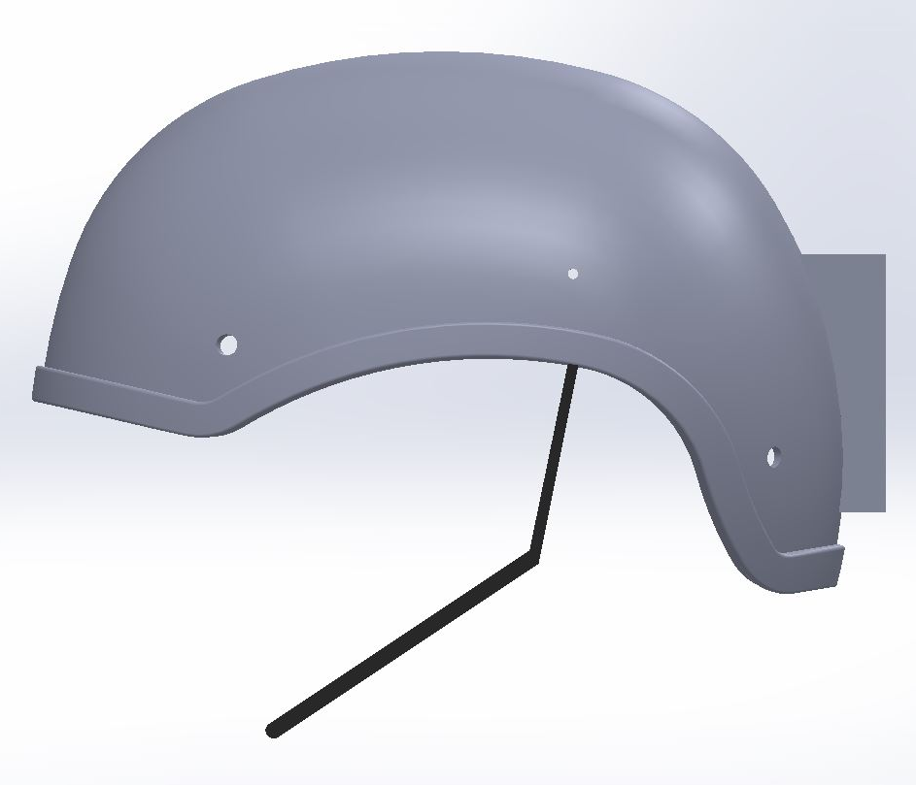
Introduction and Need
A military helmet embedded with bone conduction earphones.
Used to transfer the commands directly to the soldier.
Various problems will be solved using the design we are proposing and some of them are as below:
Need of a walky talky or headphone in order to communicate with the control room or with each other.
Need to hear the sounds from the war environment and at the same time talk to each other.

Slide 3
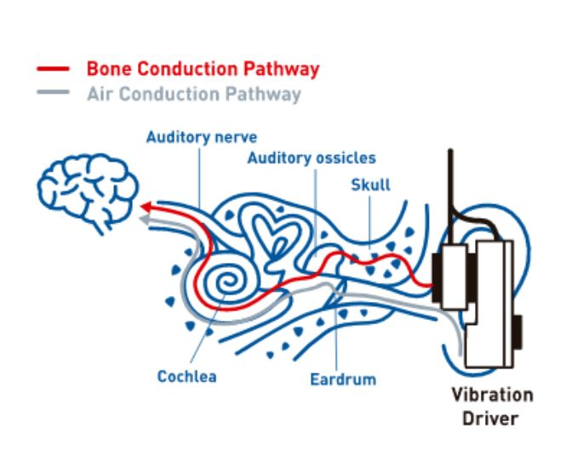
Concept and Working Principle
Human Auditory nerve, which takes audio signals from cochlea to the brain, is connected to the Organ of Corti in cochlea which is located on the basilar membrane. Therefore the displacement at the basilar membrane directly affects the sound we hear. This basilar membrane can be stimulated in 2 ways: Air Conduction and Bone Conduction.
In Normal Hearing state, the stimulation on the basilar membrane is extremely low below 100 dB.
Above 100 dB we can hear the sound even if we close our ears using ear plugs which is due to bone conduction.

Slide 4
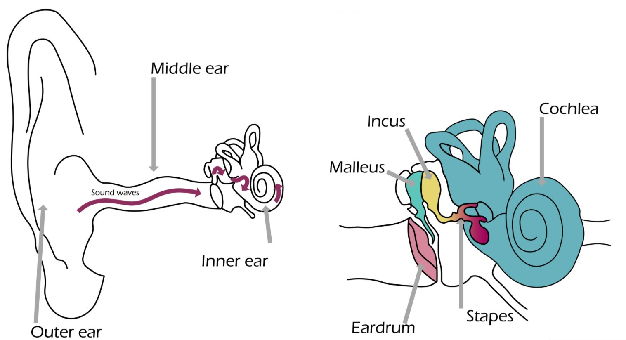
Concept and Working Principle
A person's voice sounds different to them when it is recorded and played back.
Advantage to audiologists - Through bone conduction many problems with the ear canal, the tympanic membrane or ossicles can be suspected.

Slide 5
Acoustic Simulations: Objectives
Selecting Operating Frequency Range
Calculating the Clamping Force of Transducer
Effect of External Sound on Displacement at Cochlear End
Calculating Transmission Loss within materials to be used in helmet for attenuating high Sound Pressure Level noises

Slide 6
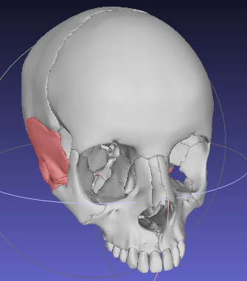
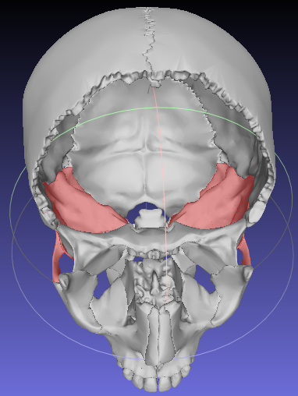
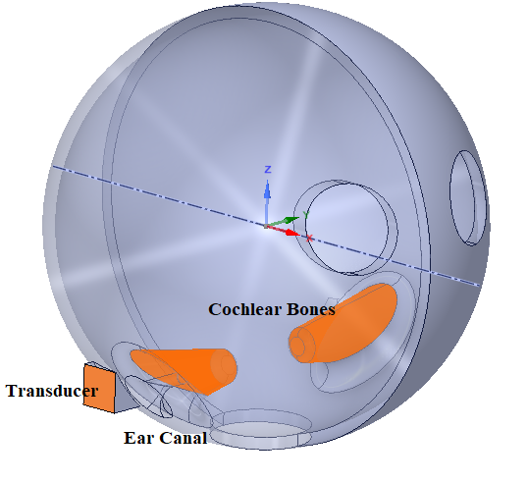
Acoustic Simulations: Modelling
Approximating Skull as Sphere:
Bone Properties:
Skull Dimensions:
Young’s Modulus E | 7300 MPa
Density | 870 kg/m³
Poisson Ratio | 0.3
Skull Thickness | 7.5 mm
Skull Diameter | 25 cm
Cochlear bone length | 7 cm
Cochlear bone diameter | 3 cm
Ear Canal Length | 3 cm
Ear Canal diameter | 8 mm
Transducer Area | 2.5 * 2.5 cm²

Slide 7
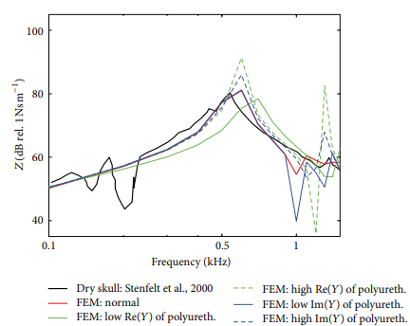
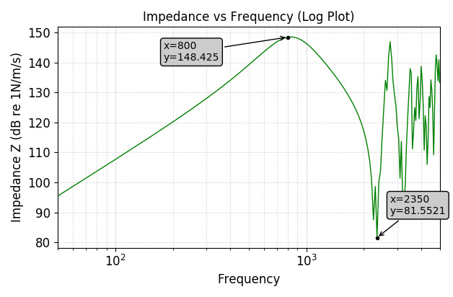
Acoustic Simulations: Model Validation
Model is Validated by giving a point load of 1 N and comparing with literature the frequency response of mechanical impedance (force/velocity)
Literature Model

Slide 8
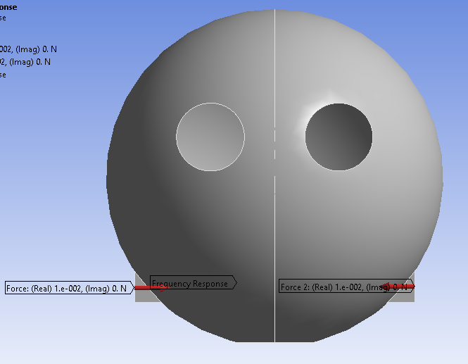
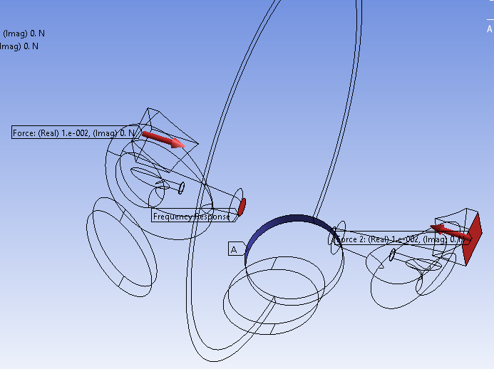
Acoustic Simulations: Frequency Selection
Frequency Range: 50 - 5000 Hz
Load: 0.01 N
Transducer Area: 2.5 cm * 2.5 cm = 6.25 * 10 ⁻ ⁴ cm²
Pressure on Transducer: 16 Pa
Boundary Conditions:
Fixed Support where skull connects the neck
Specific Force on Transducer Area on both sides
Probe:
Measure displacement at the end of cochlear bone which connects to basilar membrane

Slide 9
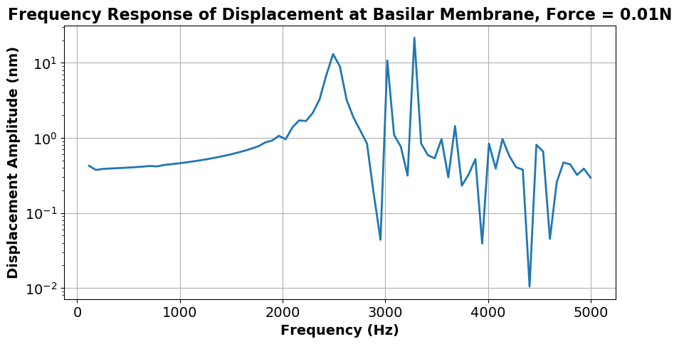
Acoustic Simulations: Frequency Selection
< 1500 Hz not possible: Transducer Limitations
>2300 Hz: Highly Nonlinear with very high disp like 10 nm
> 4000 Hz: Smaller displacements than required. Also has health implications
Selected Frequency Range:
1800 - 2200 Hz

Slide 10
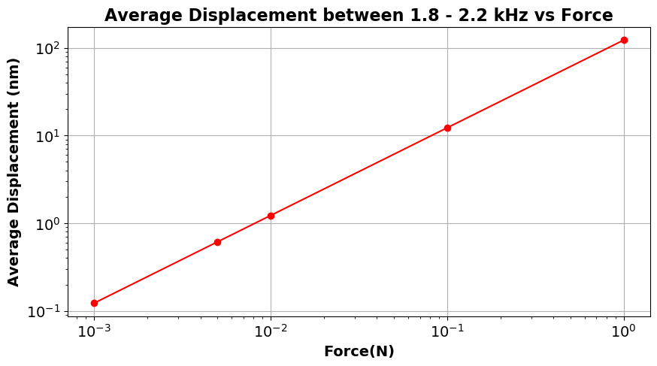
Acoustic Simulations: Applied Pressure Selection
log(disp in nm) = log(Force on Skull) + 2.089
For 0.6 nm displacement, Force amplitude on skull = 0.005 N
Pressure amplitude ∆p = 8 Pa

Slide 11
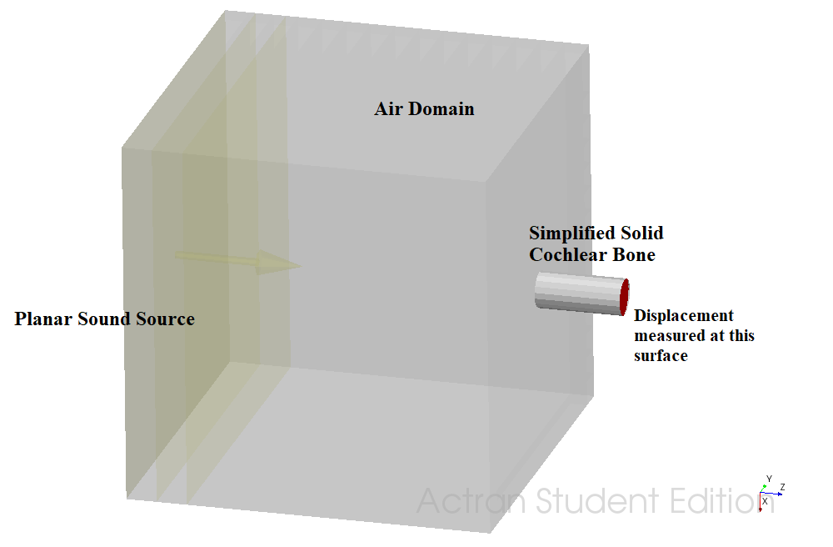
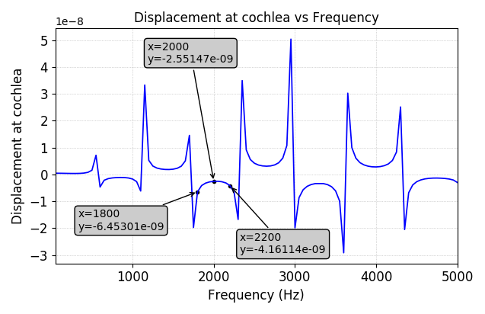
Acoustic Simulations: Acoustic Insulation in Helmet
Effect of External Sound on Displacement at Cochlear End
Air Domain | 30 cm * 30 cm * 30 cm
Cochlear bone length | 7 cm
Cochlear bone diameter | 3 cm
For 100 Pa Incident Pressure Amplitude:

Slide 12
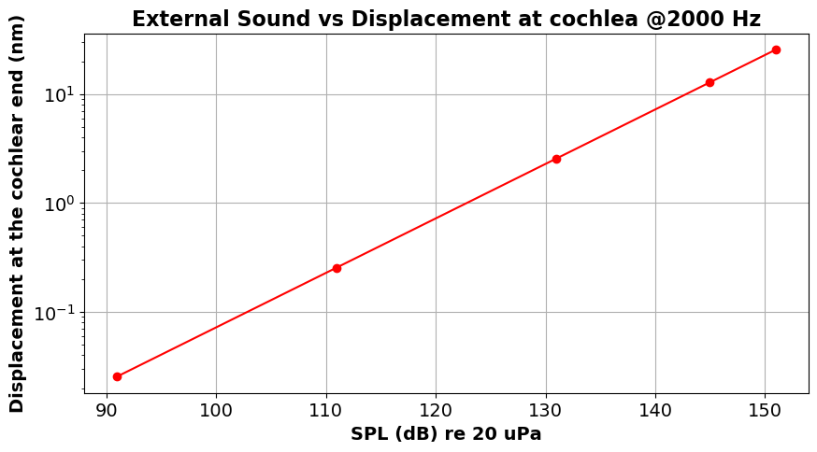
Acoustic Simulations: Need for Acoustic Insulation in Helmet
SPL(dB) = 20 * log ( P / Pref ) , where, Pref = 20 * 10⁻⁶ Pa
Above 120 dB, there is reasonable displacement due to bone conduction on the basilar membrane of cochlea
In high noise levels even if the person is wearing ear plugs, he may end up damaging his basilar membrane because sound vibrations will travel through bone conduction.

Slide 13
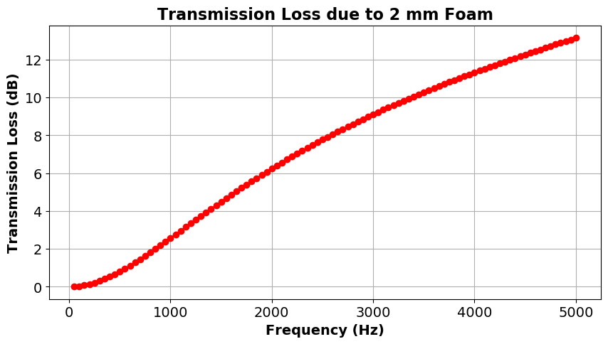
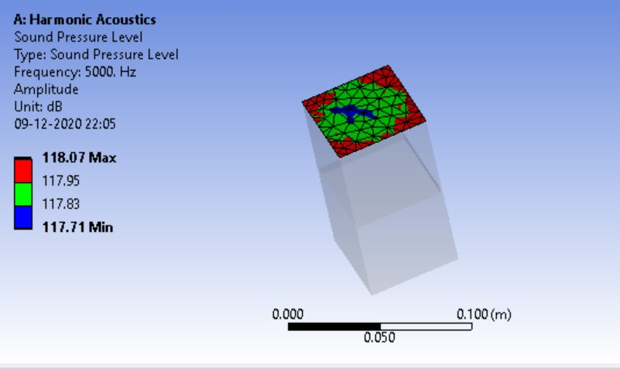
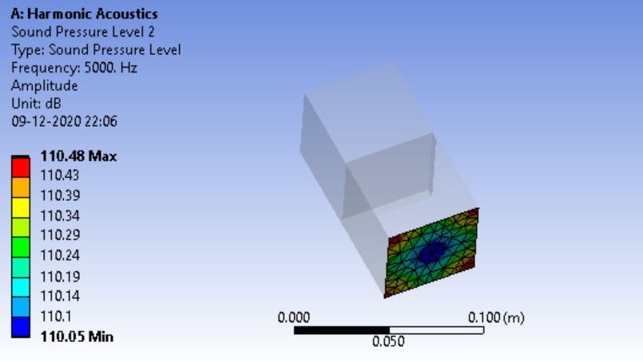
Acoustic Simulations: Transmission Loss through Foam
The bullets and bomb blasts generally create a noise at 1000 Hz of frequency
Sound to Attenuate = 40 dB
For 1000 Hz frequency , (40 / 2.5 ) * 2mm = 32mm of foam to attenuate the large noise

Slide 14
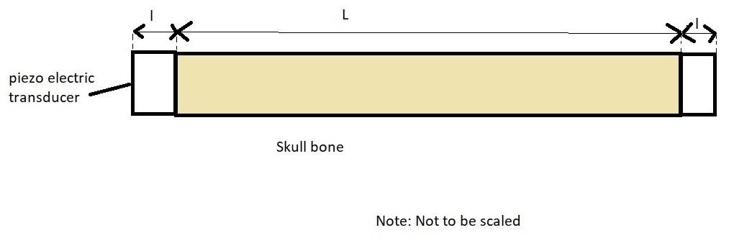
Clamping force calculation
Force amplitude on skull = 0.005 N
Pressure Amplitude ∆p = Force / Area = 0.005 / (2.5 * 2.5 cm² ) = 8 Pa
If we consider the skull bone to be stiff enough,
∆p/p =ε_{piezo} / ε
= 4*10⁻⁹/1.6*10⁻⁶
(Allowable strain corresponding to the bearable stress)
=0.0025
In our case ∆p = 8 Pa
therefore, p = 8/0.0025Pa = 3200 Pa
Clamping Force = p*A = 3200 * (2.5 * 2.5 cm²) = 2 N.
When a unit volt is passed through piezoelectric material it expands by ∆l
Therefore, ε_{piezo}=∆l/l = d*E =d*V/l
(where d is piezoelectric coefficient)
=2*10⁻¹² * (1/0.5*10⁻³)
=4*10⁻⁹

Slide 15
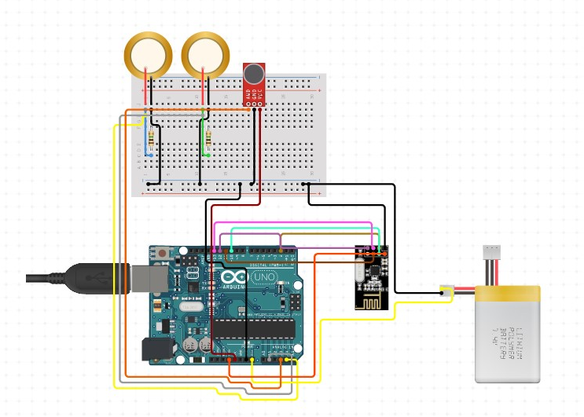
Electrical Circuit
Arduino
NRF24L01 - 2.4G Wireless Transceiver Module
Piezo Transducer
Amplifier
1.0M Ohm Resistor
Lithium Polymer Battery - 7.4v
Microphone
Wires
Perforated Board

Slide 16

Electrical Simulations
Simulations done on Tinkercad.com

Slide 17
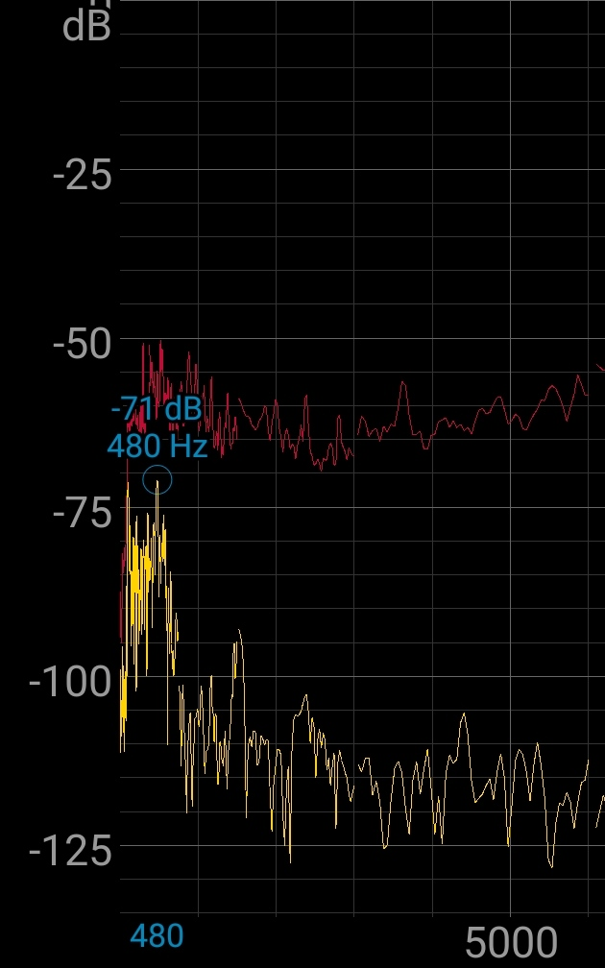
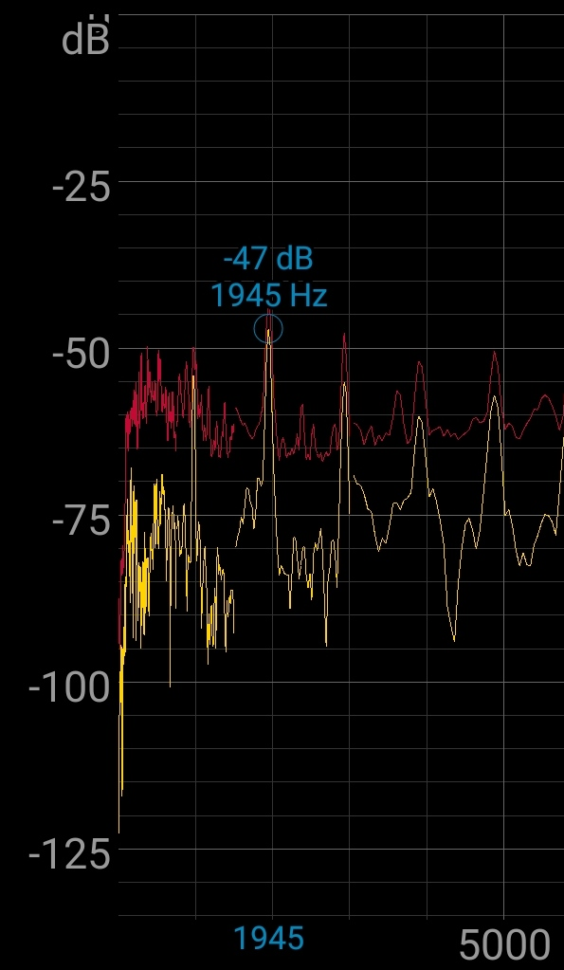
Electrical Simulations
Recorded using Spectroid App
When Piezo is off
When Piezo is on

Slide 18
Material Design iteration
Bullet: Lead 20 mm Factor of Safety = 2 Velocity of the Bullet: 500 m/s
Plate Material | Thickness | Remarks | Thickness with FOS | Mass (kg)
Steel | 0.5 mm | Failed | 1mm | 0.8
Kevlar | 0.5 mm | Failed | 1mm | 0.144
UHMWP | 0.5 mm | Failed | 1mm | 0.097
Steel | 3 mm | Passed | 6mm | 4.8
Kevlar | 3 mm | Passed | 6mm | 0.864
UHMWP | 3 mm | Failed | 6mm | 0.582
UHMWP | 4 mm | Failed | 8mm | 0.776
UHMWP | 8 mm | Passed | 16mm | 1.552

Slide 19
Material Analysis
Kevlar 3mm
UHMWP 3mm
UHMWP 4mm
UHMWP 8mm

Slide 20
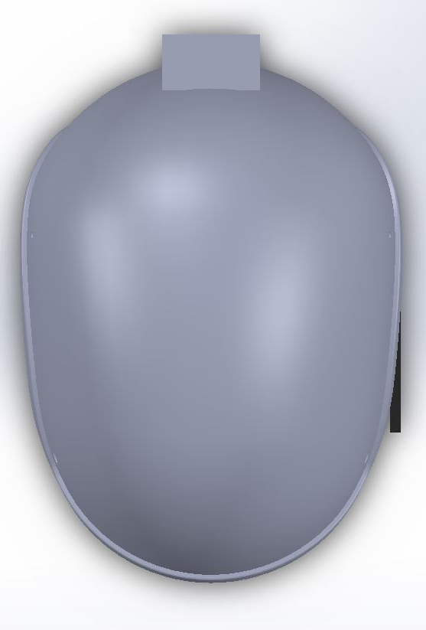
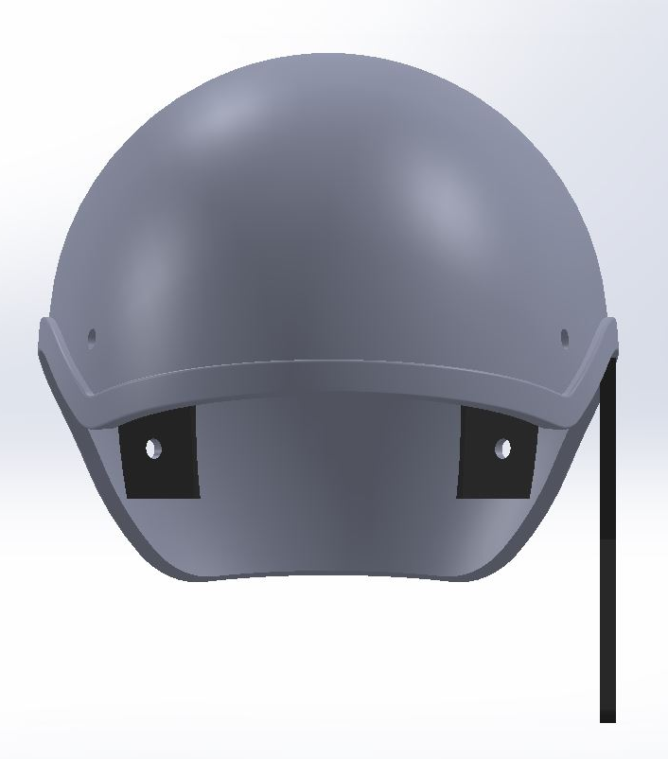
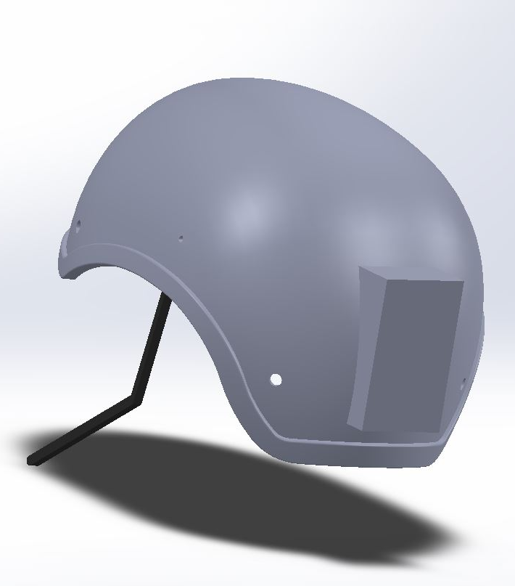
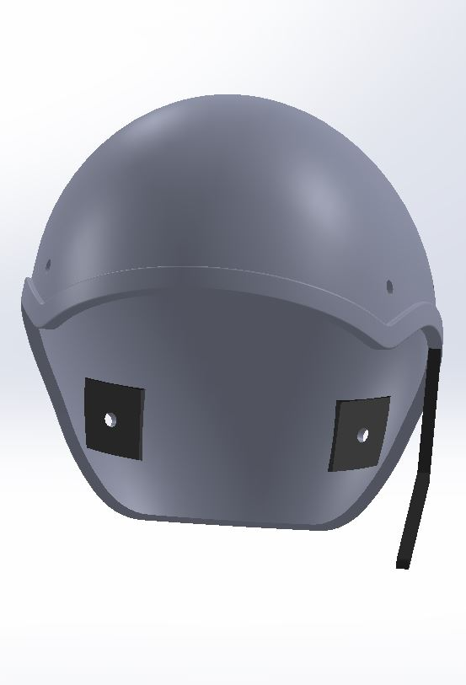
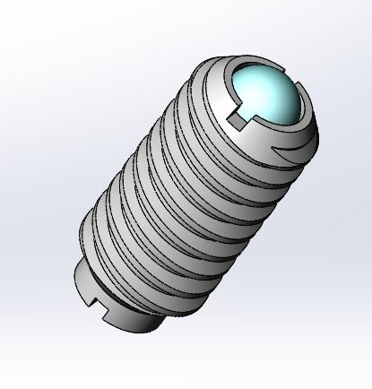
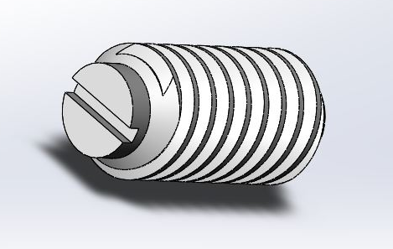
CAD Model - Helmet
Spring Plunger is added to make fine adjustments in the contact pressure
We want 0.02N change in one pitch (pitch 1.25mm)
Stiffness of spring is 0.02N/1.25mm = 16N/m

Slide 21
Final Design Specifications
Helmet Thickness - 6mm
Helmet Mass Volume - 582.93cm³
Material - Kevlar
Mass of Helmet - 864 gm
Spring Plunger pitch - 1.25mm, Stiffness = 16N/m
Transducer Area - 2.5 cm * 2.5 cm
Clamping Force - 2N
Frequency Range - 1800 - 2200 Hz

Slide 22
Bill and cost of components
Name of component | Quantity | Price
Arduino | 1 | 500
NRF24L01 - 2.4G Wireless Transceiver Module | 1 | 100
Piezo Transducer | 2 | 60
1.0M Ohm Resistor | 2 | 2
Lithium Polymer Battery - 7.4v | 1 | 1000
Microphone | 1 | 250
Wires |  | 50
Perforated Board | 2 | 80
Kevlar | 1kg | 600
Foam |  | 1000
Spring Plunger | 2 | 200
Miscellaneous |  | 500
Total |  | 4042
The total cost of components of helmet is Rs. 4042
Total weight is 1.10 kgms

Slide 23
Summary and Highlights
Final Product is a Helmet for Military Purposes with these features:
Bone Conduction transmission of sound for clear hearing of commands
Acoustically Insulating Foam for high noise levels.
Other features of helmet like bullet proofing etc.
The main aim of the project was to incorporate bone conduction transmission in helmets.

Slide 24
Contribution
Although all of us have worked collaboratively on this project and presentation, following are the leads of each part of the project. All the inferences and results were discussed and decided as a team.
Atharv Kotwal | 25% | Acoustic Simulations: Frequency, Applied Pressure, External Sound
Manan Tayal | 25% | Acoustic Insulation, Clamping force and Electronic Circuit
Amey Gohil | 25% | CAD Modelling and Acoustic Insulation
Milind Chandnani | 25% | External Sounds Simulations and Ansys Impact Analysis

Slide 25
Thank You

